Slide 1
PANIMALAR ENGINEERING COLLEGE B.E.COMPUTER SCIENCE AND ENGINEERING 21CS1512-SOCIALLY RELEVANT MINI PROJECT DOMAIN:WEBSITE DEVELOPMENT
TITLE:OVIYA GHEE
BY
REVIVELIN DEBORAH N J(211422104395)
RATHI .V(211422104386)
MENTOR
Mrs.S.LINCY JEMINA,M.E,(Phd)

Slide 2
ABSTRACT:
This project focuses on developing a dynamic and user-friendly website for Oviya
Ghee Company to enhance customer engagement and streamline purchasing. The
website showcases a variety of ghee products with multiple quantity options,
allowing customers to select their desired size with ease. A key feature of the
platform is an integrated chatbot that assists users in discovering recipes made
using ghee, offering personalized suggestions to enhance their culinary experience.
The website also supports seamless ordering, quantity selection, and secure
payments through multiple transaction methods, ensuring a smooth and convenient
shopping process. This solution aims to improve customer interaction, simplify
purchases, and provide value-added services, ultimately boosting the brand’s
online presence and customer satisfaction.

Slide 3
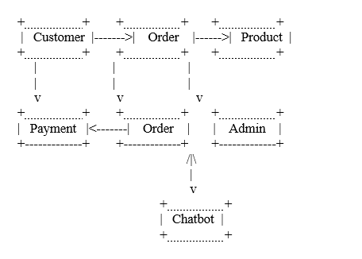
ARCHITECTURE DIAGRAM:

Slide 4
INTRODUCTION:
Founded in 2004, Oviya Ghee Company began as a small business with a commitment to providing pure, high-quality ghee to customers. Over the years, the company steadily grew, earning trust for its traditional production methods and authentic taste. With a focus on purity and sustainability, Oviya Ghee became a well-known name in households across the region.
In 2024, marking its 20th anniversary, the company expanded its operations to wholesale markets, catering to restaurants, bakeries, and other commercial buyers. This milestone reflects Oviya Ghee’s continuous growth and commitment to serving a broader customer base while maintaining the same quality and values that defined its origins.

Slide 5
DEVELOPMENT ENVIRONMENT
SOFTWARE REQUIREMENTS:
IDE:Visual Studio Code
Language:HTML,CSS,JAVASCRIPT(FRONTEND),NODE JS(BACKEND)
Database:MongoDB

Slide 6
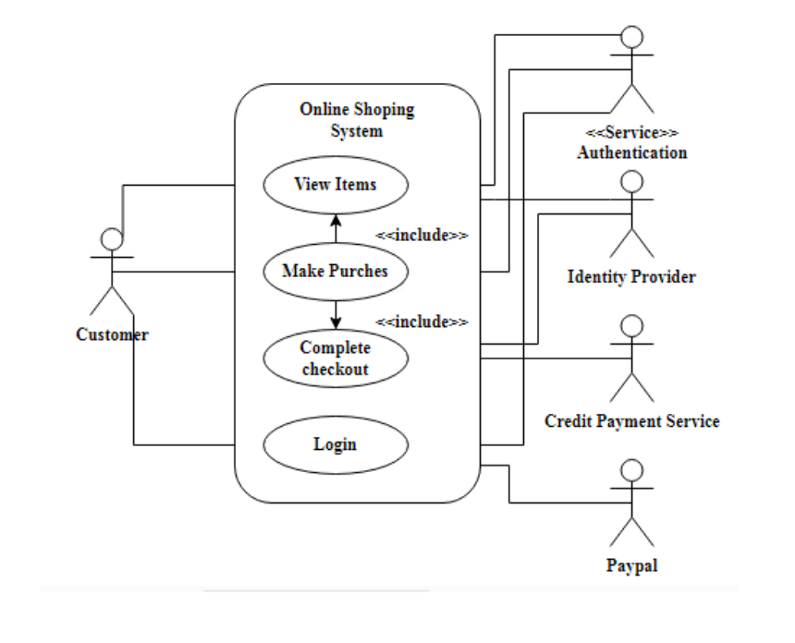
USE CASE DIAGRAM:

Slide 7
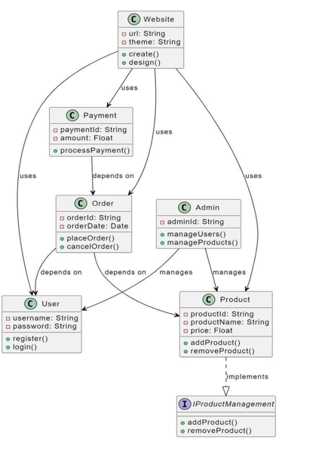
CLASS DIAGRAM:

Slide 8
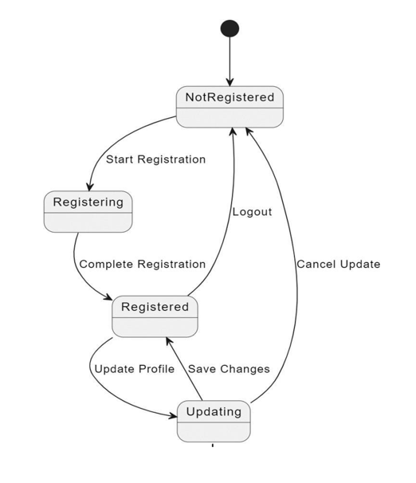
STATE DIAGRAM:

Slide 9
EXISTING MODEL:
Basic Product Catalogs and Quantity Selection
Many online platforms provide product catalogs that allow users to view products with options for selecting different quantities. These systems offer features such as filters, price comparisons, and customer reviews to enhance shopping experiences.
Recipe Blogs and Cooking Platforms
Some companies, such as dairy brands, maintain separate recipe blogs or integrate recipe sections within their product websites to inspire customers to use their products creatively.
Ordering And Payment System
Current e-commerce systems offer a variety of payment methods, including credit cards, UPI, wallets, and net banking. They also support order tracking and notifications for customer convenience.

Slide 10
PROPOSED MODEL:
The proposed system for Oviya Ghee Company focuses on building an e-commerce website that not only provides easy access to its product range but also enhances customer interaction through a value-added service. The key components of the system include:
Product Catalog with Quantity Selection:
A well-organized product catalog displaying various types and quantities of ghee.
Filters to help customers select products based on their preferences (e.g., organic, flavored, bulk sizes).
Chatbot for Recipe Search and Recommendations:
A conversational AI-powered chatbot integrated into the website.
The chatbot suggests recipes made with ghee based on user input or product selection.
Personalized interaction to help customers discover new culinary uses for ghee, enhancing engagement and satisfaction.
Seamless Ordering and Checkout Process:
Users can easily browse, select quantities, and add products to the cart.
A smooth checkout process with detailed order summaries and multiple shipping options.
Secure Payment System with Multiple Transaction Options:
Support for credit/debit cards, UPI, digital wallets, net banking, and cash on delivery.
Integrated with a secure payment gateway to ensure smooth transactions and customer trust.
Order Tracking and Notifications:
Real-time notifications via email or SMS regarding order status and shipment tracking.

Slide 11
MODULE DESCRIPTION:
OVIYA GHEE CONSISTS OF 6 MAIN MODULE
1.Login page
2.Home page
3.Product page
4.Aboutus page
5.Contact info page
6.Chatbot page

Slide 12
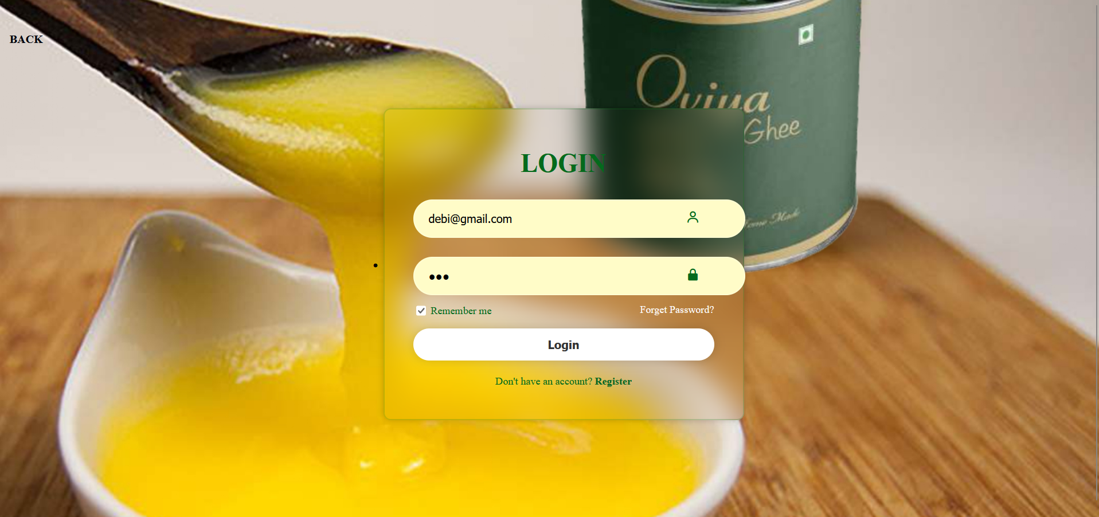
LOGIN PAGE:

Slide 13
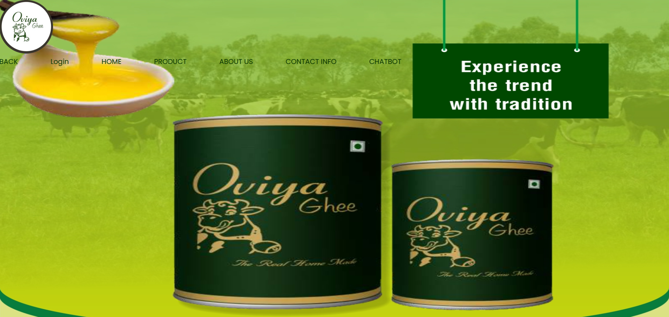
HOME PAGE:

Slide 14
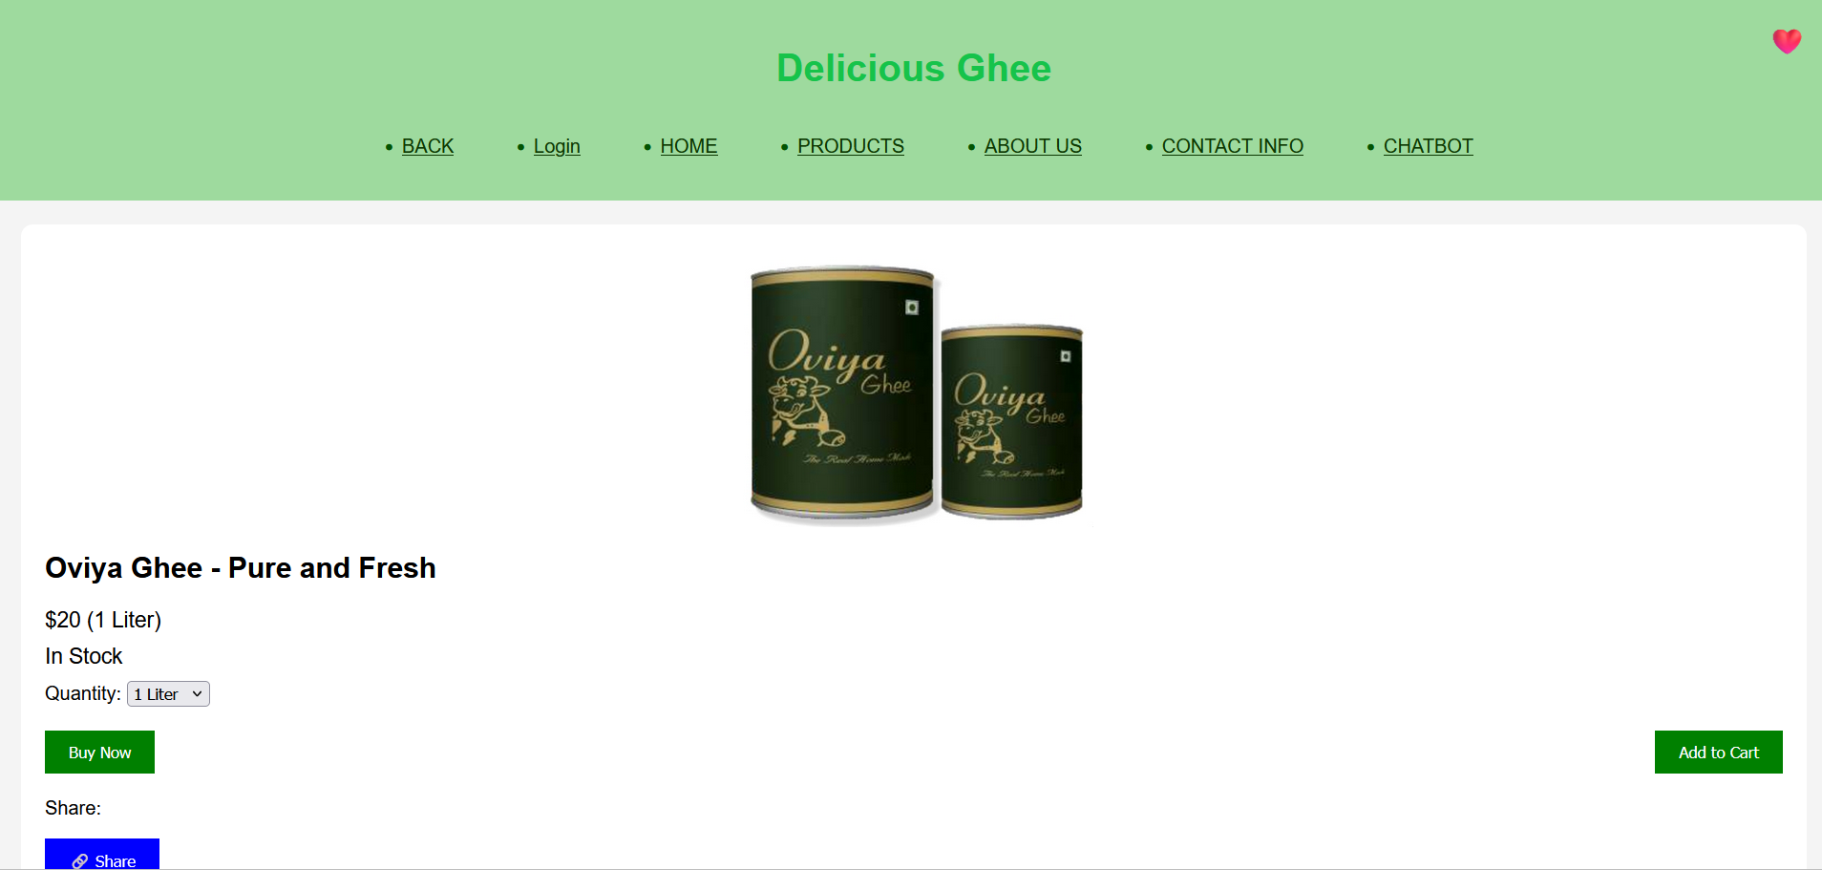
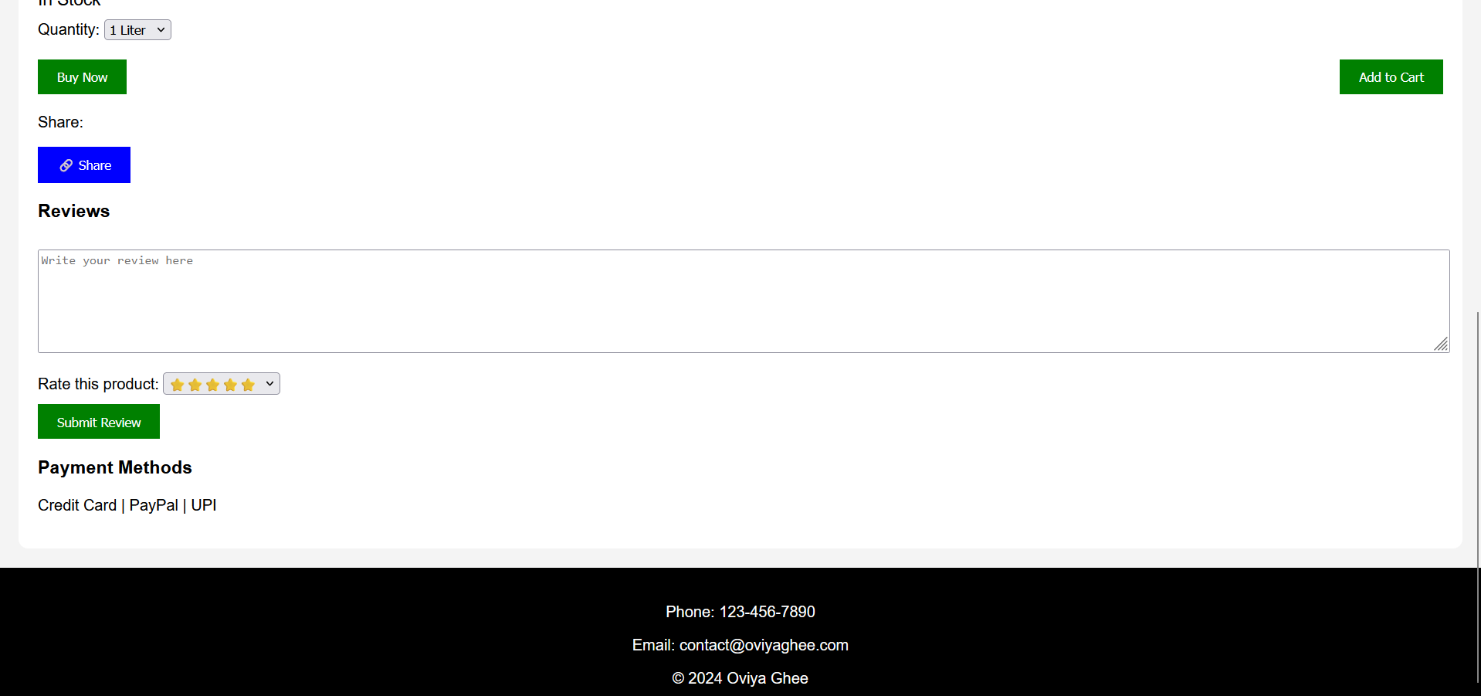
PRODUCT PAGE:

Slide 15
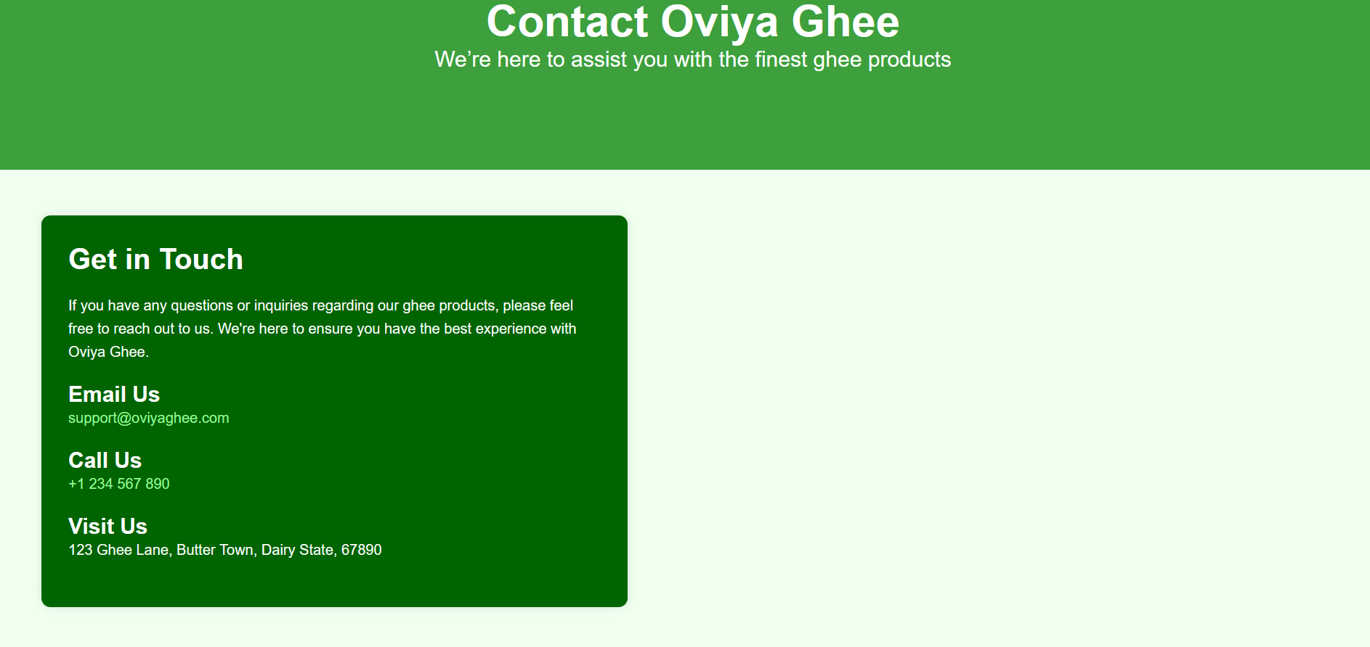
CONTACT INFO PAGE:

Slide 16
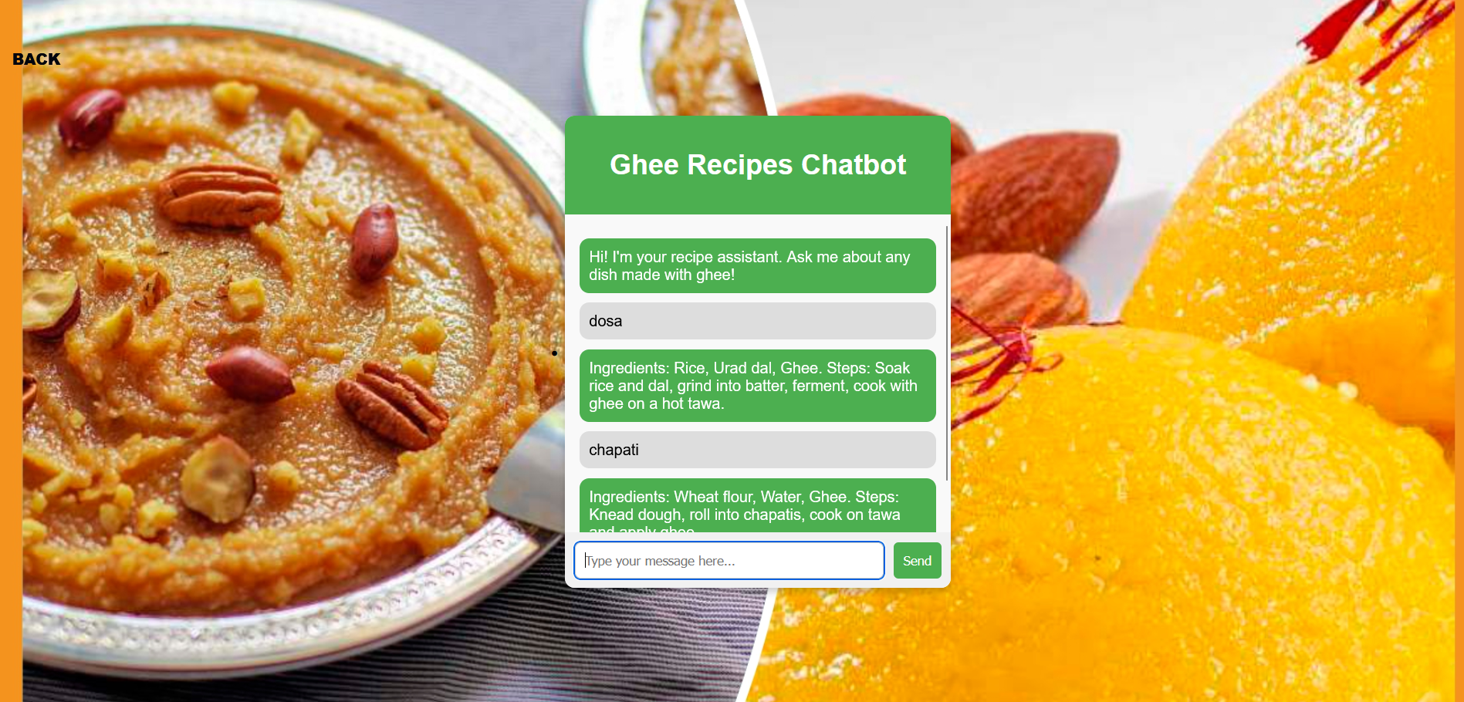
CHATBOT PAGE:

Slide 17
CONCLUSION:
The development of the Oviya Ghee Company e-commerce website provides a seamless platform for users to browse and purchase ghee products efficiently, with the added benefit of a chatbot-powered recipe search feature. The system is designed to ensure smooth operations through a modular structure, allowing customers to order products with ease, select quantities, and complete payments securely via multiple transaction options.
The integration of essential modules—such as product management, order processing, payment gateway, and notifications—ensures both customers and administrators experience streamlined interactions. Additionally, the chatbot enhances customer engagement by offering real-time recipe suggestions, encouraging product usage beyond simple consumption.
By following best practices in system design, secure payment integration, and comprehensive testing, the solution offers reliability, scalability, and a user- friendly experience. With future-ready architecture and features, the platform can easily evolve with business growth, supporting higher traffic and new functionalities. Overall, the Oviya Ghee website promises to be an effective digital channel for the company to reach and serve customers efficiently.

Slide 18
FUTURE ENHANCEMENT:
Mobile Application Development
Launch a dedicated mobile app for Android and iOS to enhance accessibility and improve the user experience. Enables on-the-go shopping, personalized notifications, and easier order tracking.
Multi-language and Multi-currency Support
Add support for multiple languages and currencies to cater to international customers.
Expands the business to global markets and improves the shopping experience for non-local users.
Voice-activated Shopping and Recipe Suggestions
Integrate voice search functionality for products and recipes through platforms like Google Assistant or Alexa. Makes the platform more accessible and future-proof by aligning with voice- based interactions.
Faster Delivery through Logistics Partnerships
Collaborate with third-party logistics providers to offer faster delivery options, including same-day or next-day delivery. Enhances customer satisfaction and reduces delivery times.

Slide 19
REFERENCES:
Kumar et al. (2018)
Jain et al. (2019) showed that chatbots offering personalized recommendations
Sarwar et al. (2017) found that personalized recommendations based on customer interests
Agrawal et al. (2018), offering multiple payment modes—such as credit/debit cards, UPI, wallets, and net banking—boosts trust and convenience.

Slide 20
THANK YOU

